Slide 1

TEXT CLASSIFICATION SYSTEM
Sentiment Analysis

Slide 2


Project Overview
Code Implementation
Table of Contents
Model Deployment
Live Demo

Slide 3

Project Overview

Slide 4


Project Overview
Our project focuses on developing a sentiment analysis model to classify tweets into positive and negative categories.
By leveraging advanced machine learning techniques, we aim to provide valuable insights into public sentiment on various topics expressed through Twitter.

Slide 5
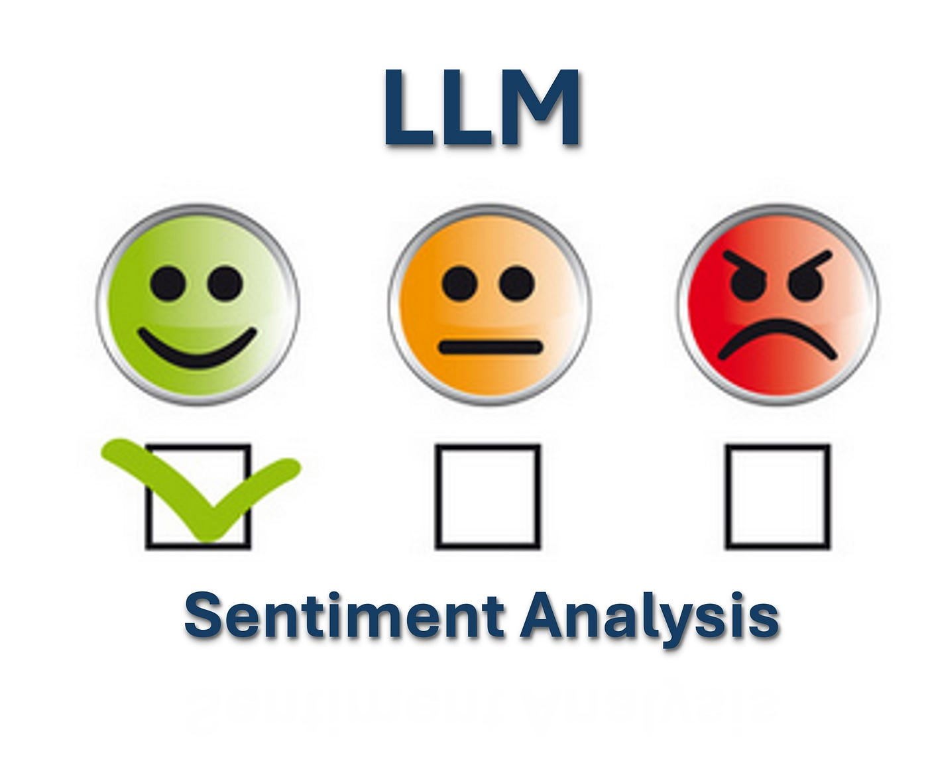
Objectives
Accurate Sentiment Classification: Build a robust model to accurately predict whether a tweet conveys a positive or negative sentiment.

Slide 6

Key Benefits
Business Insights: Understand customer opinions and improve decision-making.
Research Advancements: Facilitate studies on public sentiment and social trends.
Social Media Analytics: Enhance analysis of social media interactions and trends.

Slide 7
Dataset Description: Sentiment 140

Slide 8
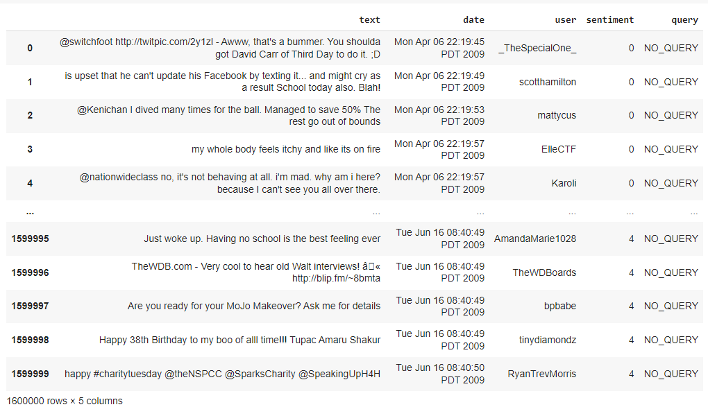
Overview
The Sentiment140 dataset is a comprehensive collection of 1,600,000 tweets extracted using the Twitter API.
It is meticulously annotated to facilitate sentiment detection, making it an invaluable resource for training and evaluating sentiment analysis models.

Slide 9
Context
The Sentiment140 dataset offers a rich set of data points for classifying sentiments expressed in tweets. Each tweet is annotated with a sentiment polarity:
0 for negative sentiments
2 for neutral sentiments (not used in this project)
4 for positive sentiments
For this project, we focus on binary sentiment classification, specifically distinguishing between positive and negative sentiments.

Slide 10
Content
The dataset consists of six fields:
target: The polarity of the tweet, with values indicating sentiment:
0 = Negative
2 = Neutral (not used in this project)
4 = Positive
ids: The unique identifier for the tweet.
date: The timestamp of when the tweet was posted
flag: The query associated with the tweet. If no query exists, this field is marked as NO_QUERY.
user: The username of the individual who tweeted.
text: The content of the tweet itself.

Slide 11
Code Implementation

Slide 12
Dataset Loading and Preparation
First, we Loaded the Sentiment140 dataset, which contains 1.6 million tweets.
The dataset includes sentiment, id, date, query, user_id, and text.
Preparation Steps:
Drop unnecessary columns: id, date, query, and user_id.
Retain only sentiment and text columns for processing.
Map sentiment values to "Positive" and "Negative" for binary classification.

Slide 13
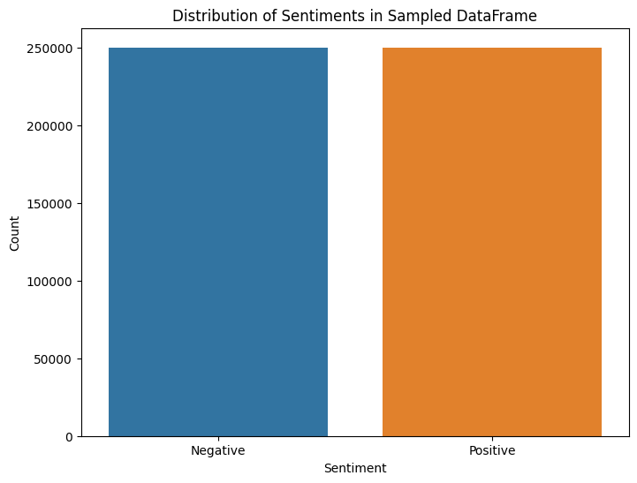
Sampling
Objective: Balance the dataset and reduce processing time.
Method: Randomly sample 500,000 tweets from the original dataset.
Result: Maintain the distribution of sentiment categories in the sample.

Slide 14
Overview of Text Preprocessing
Purpose:
Prepare raw text data for analysis.
Ensure effective learning for sentiment analysis models.
Key Steps:
Remove Usernames
5. Remove Stop Words
2. Tokenization
6. Lemmatization
3. Normalize to Lowercase
7. Filter Meaningful Tokens
4. Clean Tokens

Slide 15

Example Tweet
I love the new features of @Twitter! They're amazing. #excited
Original Tweet

Slide 16
Step 1 - Remove Usernames
Action: Eliminate mentions from the text.
“I love the new features of ! They're amazing. #excited”
Transformed Text

Slide 17
Step 2 - Tokenization
Action: Split text into individual tokens (words).
['I', 'love', 'the', 'new', 'features', 'of', '@Twitter', '!', 'They\'re', 'amazing', '.', '#excited']
Tokens

Slide 18
Step 3 - Normalize to Lowercase
Action: Convert all tokens to lowercase.
['i', 'love', 'the', 'new', 'features', 'of', '@twitter', '!', 'they\'re', 'amazing', '.', '#excited']
Transformed Tokens

Slide 19
Step 4 - Clean Tokens
Action: Filter out non-alphanumeric tokens.
['i', 'love', 'the', 'new', 'features', 'of', 'they\'re', 'amazing']
Cleaned Tokens

Slide 20
Step 5 - Remove Stop Words
Action: Eliminate common stop words.
['love', 'new', 'features', 'they\'re', 'amazing']
Filtered Tokens

Slide 21
Step 6 - Lemmatization
Action: Reduce words to their base form.
Lemmatized Tokens
['love', 'new', 'feature', 'they\'re', 'amazing']

Slide 22
Step 7 - Filter Meaningful Tokens
Action: Ensure tokens are meaningful (length ≥ 3).
Meaningful Tokens
['love', 'new', 'feature', 'amazing']

Slide 23
Final Step - Join Cleaned Tokens
Action: Combine tokens into a single string.
Final Preprocessed Text
love new feature amazing

Slide 24
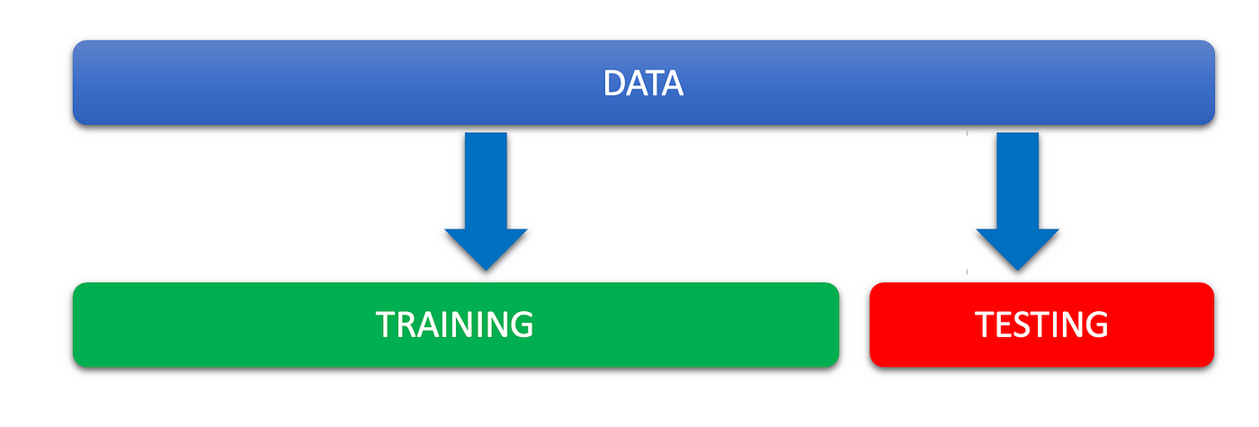
Data Splitting
Overview:
The pre-processed data is divided into training and testing sets.
Splitting Details:
Training Set: 80% of the data
Testing Set: 20% of the data
Purpose:
Ensure robust model evaluation and prevent overfitting.

Slide 25
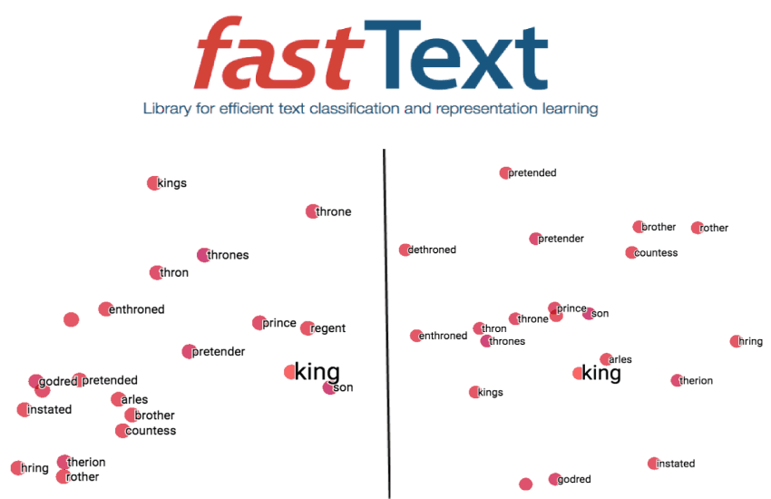
Text Vectorization
Purpose: Convert text data into numerical format for model training.
Process:
Training FastText Model: Generates word embeddings from the training data.
Tokenization: The text data is tokenized into sequences.
Padding: Sequences are padded to ensure uniform length across the dataset.

Slide 26
Model Building
Embedding Layer: Initialized with the embedding matrix from FastText, using a vocabulary size and embedding dimension specific to our dataset.
Single LSTM Layer: Incorporating dropout to capture dependencies and provide regularization.
Dense Layer: A fully connected layer with fewer units to reduce complexity.
Output Layer: A sigmoid activation function for binary classification.

Slide 27
Model Compilation
Optimizer: Adam
Loss Function: Binary Cross-Entropy
Tracking: Accuracy is monitored during training to evaluate model performance.

Slide 28
Model Training
The model is compiled and trained on the training data using the following parameters:
Epochs: 5, which defines the number of complete passes through the training dataset.
Batch Size: 64, which indicates the number of samples processed before the model is updated.
Validation Split: 0.2, meaning 20% of the training data is used for validation to monitor the model's performance during training.

Slide 29
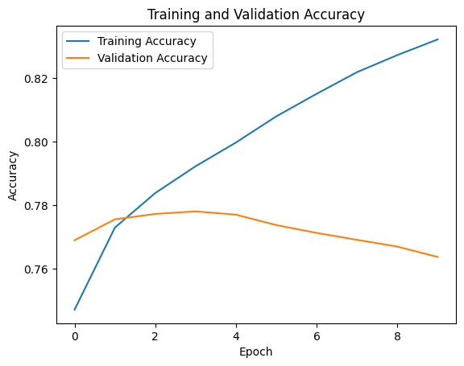
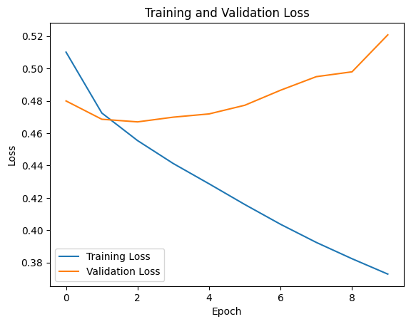
Model Training and Validation History

Slide 30
Evaluation
The model’s performance is evaluated on the test data using a confusion matrix and classification report, providing insights into its accuracy and effectiveness.
The trained model is saved in HDF5 format for future use, allowing for easy loading and deployment.

Slide 31
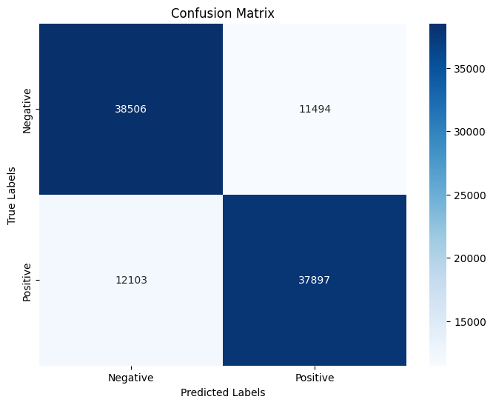
Confusion Matrix

Slide 32
Model Deployment

Slide 33

FastAPI Implementation
We developed an API using FastAPI to facilitate sentiment analysis based on our trained model.
We saved the sentiment analysis model and tokenizer to ensure efficient loading during request handling.

Slide 34
FastAPI Implementation
To maintain consistency in text handling, we applied the same preprocessing techniques used during model training, which included removing usernames, tokenization, normalization, and filtering for meaningful tokens.

Slide 35

Deployment with Streamlit
To enhance user interaction, we deployed the sentiment analysis model using Streamlit. This framework provided a user-friendly interface for text input and sentiment analysis.

Slide 36
Deployment with Streamlit
The application features a responsive design with clear instructions for users. Upon submission, the application communicates with the FastAPI backend, sending the input for sentiment prediction.
Results are displayed visually, indicating the sentiment along with a confidence score. Custom styling enhances the user experience, making the tool intuitive and engaging.

Slide 37
Live Demo

Slide 38
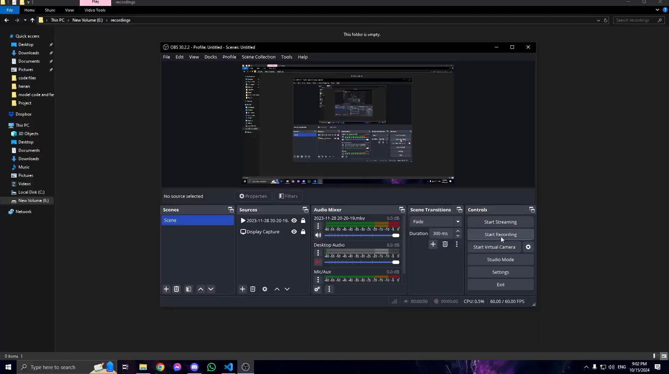

Slide 39
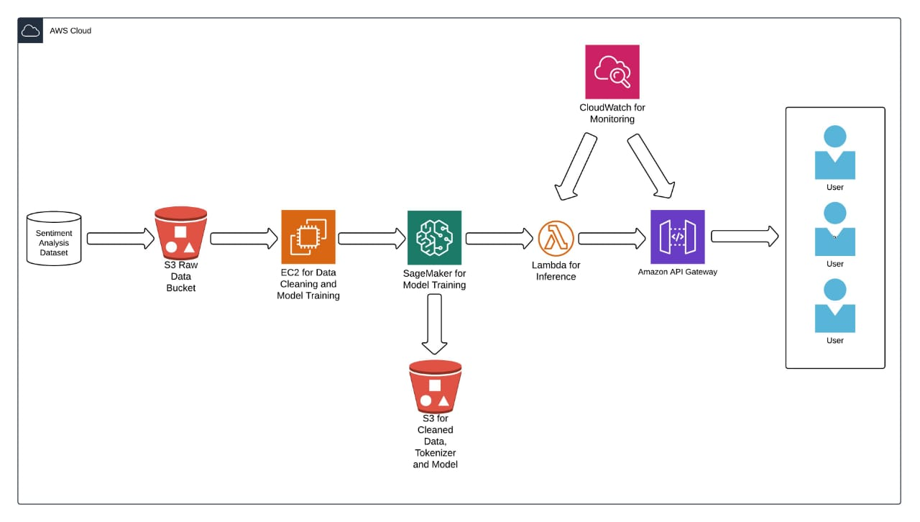
AWS Flowchart Implementation

Slide 40
THANK YOU!
FOR YOUR ATTENTION

